Slide 1
REMIT in practice: data collection, market monitoring and stakeholder responsibilities
Erik Rakhou
Seconded National expert,
Market Monitoring Department
North-West European Regional Stakeholder group meeting
SG GRI NW, Stockholm, 28 November 2013

Slide 2
Disclaimer
The information and views set out in this presentation are those of the speaker and do not reflect the official position of the Agency for the Cooperation of Energy Regulators (ACER), unless expressly stated otherwise in written.
This presentation is provided for information only and does not constitute formal guidance from ACER.
Market participants, where necessary, should seek legal advice on their legal position.

Slide 3
Outline
Introduction
Data collection
Market Monitoring
Stakeholder responsibilities

Slide 4
Part 1
What is REMIT ?
General introduction REMIT, timelines and organisation of work.

Slide 5
What REMIT is about
REMIT is Regulation of the European Parliament and of the Council on Wholesale Energy Markets Integrity and Transparency. REMIT:
Defines and introduces
prohibitions of
market manipulation and attempted market manipulation
insider trading; and
obligations of
disclosure of insider information
transaction reporting
Establishes:
a new framework for the monitoring of wholesale energy markets to detect and deter market manipulation and insider trading
Provides:
enforcement of the above prohibitions and the sanctioning of breaches of market abuse rules at national level.

Slide 6
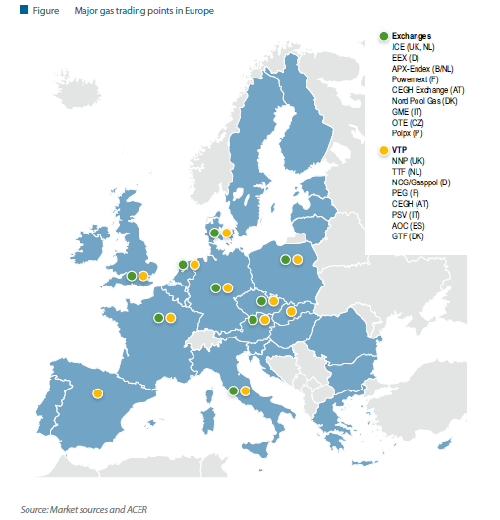
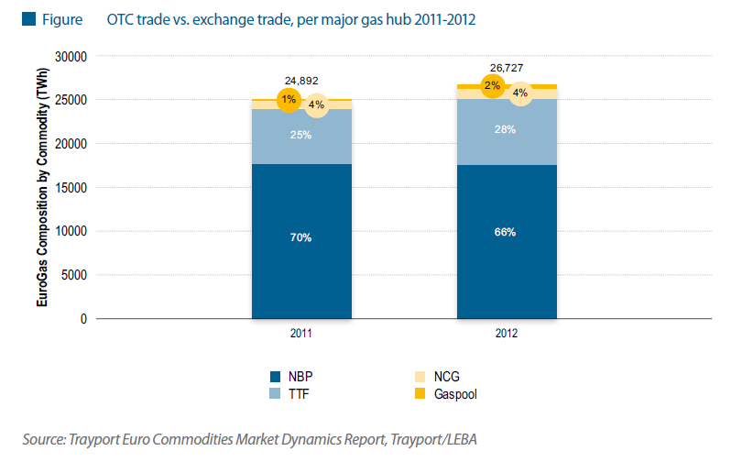
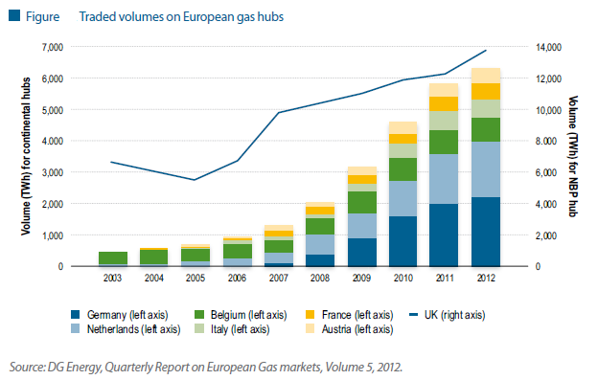
Transparency and integrity in price formation are key to developing European gas trading

Slide 7
ACER plays a key role in REMIT implementation

Slide 8
REMIT implementation is at full speed
When will REMIT be fully implemented?
REMIT dependant
Implementing Acts dependent
REMIT enters into force
Prohibitions and Obligations apply
6 months
“Registration Format” for CEREMP published by ACER
18 months
NRA enforcement competences implemented into national law
Adoption of the Implementing Acts defining data being reported
within 3 months
NRAs have to set up the register (CEREMP assists)
after 6 months
Data reporting and monitoring by ACER
December 2011
June 2012
June 2013
?

Slide 9
ACER Remit team engagement with NRAs, industry experts and stakeholders
ACER’s REMIT Working Group, Task Forces and Expert Groups
ACER’s Operational Departments
Gas Department
Market Monitoring Department
(REMIT)
Electricity Department
Market Integrity and Transparency
Working Group
(NRAs)
Wholesale Market Surveillance
Task Force (NRAs)
Market Monitoring Governance
Task Force (NRAs)
Information Technology (IT)
Task Force (NRAs)
WMS
Expert Group
(Industry Experts)
MMG
Expert Group
(Industry Experts)
IT
Expert Group
(Industry Experts)
Further engagement through Workshops, Roundtables and Pilot Project for REMIT implementation

Slide 10
Part 2
REMIT – how is relevant data collected.
IT-approach explained.
Pilot project introduced.

Slide 11
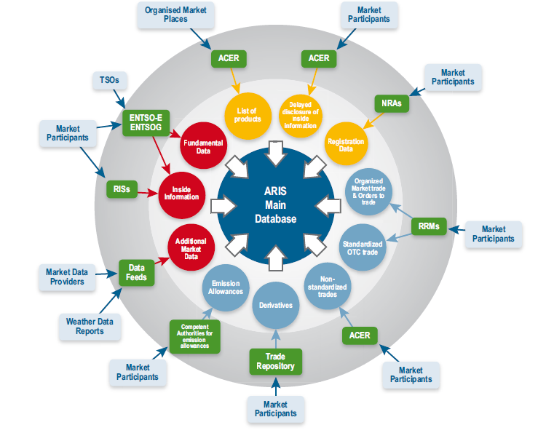
Transaction Reporting: data sourcing from multiple sources, focus at holistic view without double reporting

Slide 12
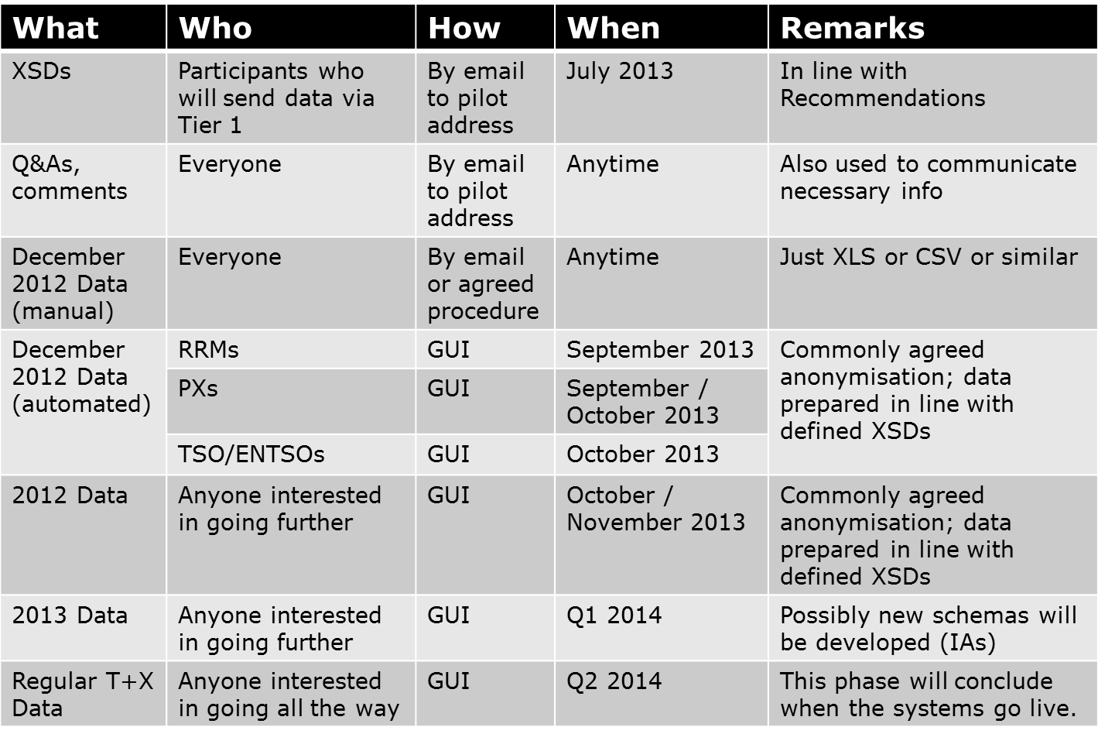
Example of pilot ‘homework’, outlined on 11 July 2013 kick-off:
To prepare for data collection pilot was launched
Goal:
prepare for ‘2014’, minimalistic and very basic trial, proof of concept ARIS
Scope:
Market Monitoring (focus on special software testing)
Data collecting
Illustrative key parties (PXs, Broker(s) and/or RRMs, TSO and/or ENTSO, energy companies for non-standard)
Timing/steps:
Q2 – Q4 2013

Slide 13
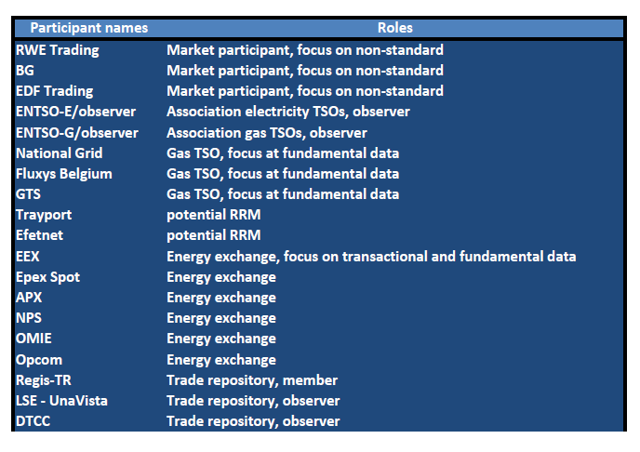
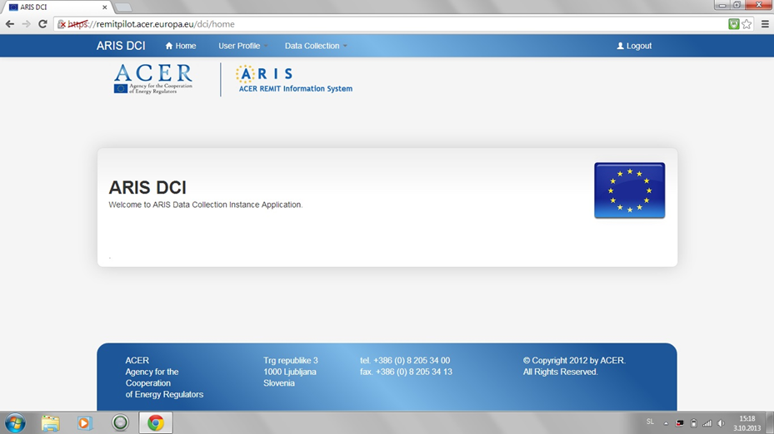
Initial lessons learned 1st phase
Data delivery proved challenging, yet possible with substantial efforts for a number of participants.
Data validation importance was underlined, next to complexities of preparing data and submission. Final evaluation is ongoing.

Slide 14
The 2nd phase ‘ARIS Operational prototype’ started.
Data collection and IT system
preparation continues
2nd pilot phase was kicked-off 25 November with some of the existing pilot participants and 5 additional new participants applied by 22 November 2013.
2nd phase will precede the ‘go-live’ phase.
2nd phase is planned to further enhance ARIS development and to result in consistently anonymised data delivery of 2012 & 2013 data by pilot parties in accordance with specified by ACER formats.
ARIS prototype data collection interface will be continuously open and updated during the 2nd phase.
Evaluation & next steps are planned for April 2014.

Slide 15
Part 3
REMIT – market monitoring approach.

Slide 16
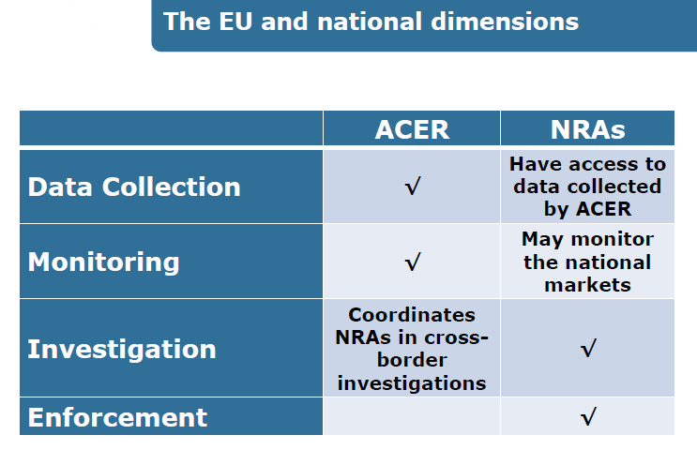
EU market monitoring provides for close co-operation between ACER and NRAs. Other relevant authorities – such as FMAs - may need to be involved or informed.

Slide 17
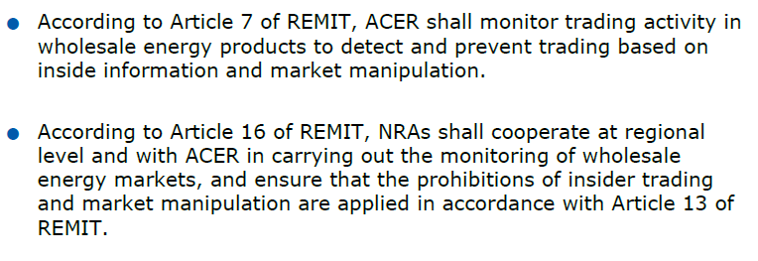
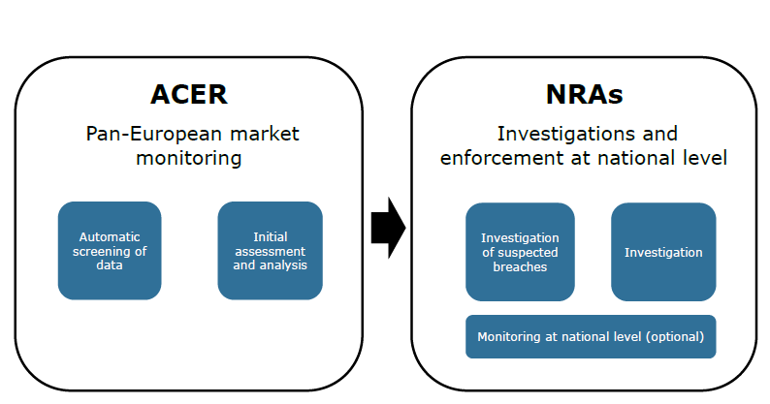
Market monitoring and enforcement workflow further explained.

Slide 18
How does Monitoring at EU-level work?
ACER‘s approach to market monitoring
1
Data Acquisition
Trade Data
Fundamental Data
Coordination of NRAs (if needed)
Automatic Screening to identify “Anomalous Events”
2
Notification of “Suspicious Events” to NRA(s)
Monitoring Methodology: “Anomalous Events” definition
Preliminary analysis of “Anomalous Events”
3

Slide 19
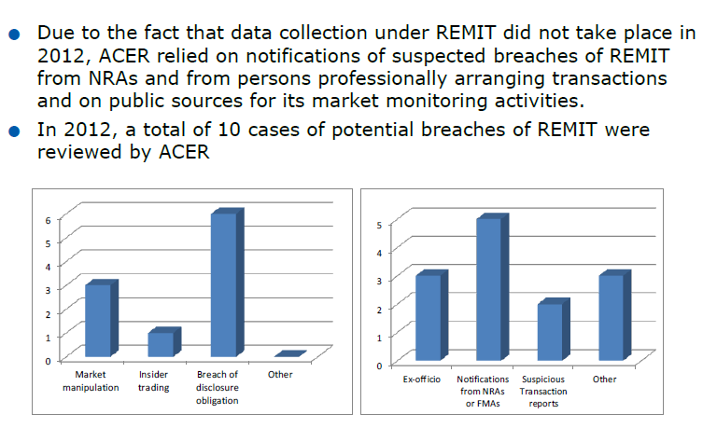
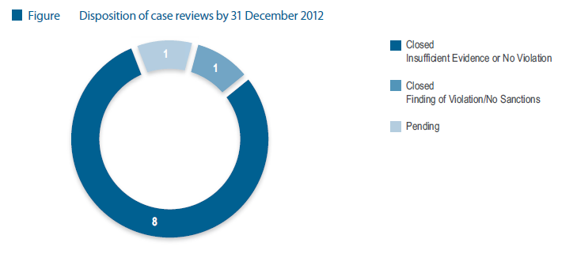
Case overview, as published in annual REMIT report 2012

Slide 20
PPAT obligations (article 15 REMIT)
Persons professionally arranging transactions
(PPATs)
shall monitor markets and report suspicious transactions

Slide 21
Part 4
REMIT – stakeholder responsibilities

Slide 22
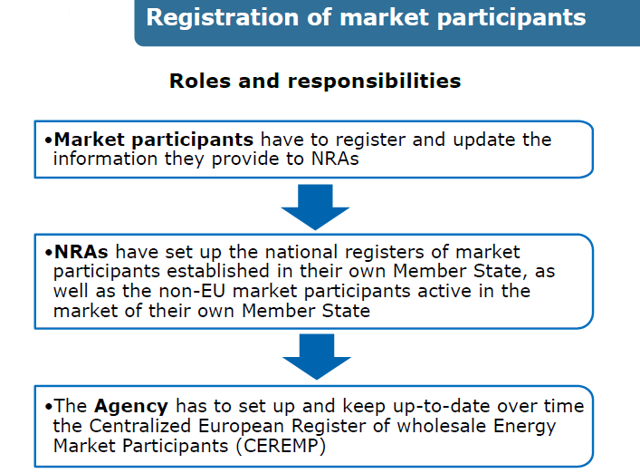
Market parties need to register – expectedly from 1H 2014 onwards

Slide 23
ACER’s Guidance contains non-binding explanation on key REMIT provisions
Non-binding
Directed to NRAs to ensure the required coordination and consistency in their monitoring activities under REMIT
Made public for transparency purposes only
Updated from time to time to reflect changing market conditions and the experience gained by the Agency and NRAs in the implementation of REMIT
1st edition published in December 2011, 2nd edition published in October 2012
3rd edition was published in October 2013

Slide 24
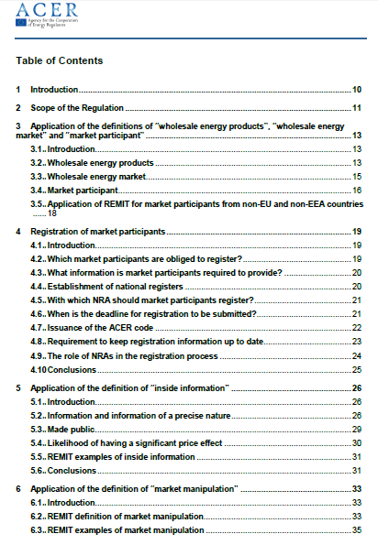
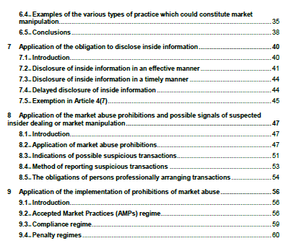
3rd edition of ACER’s guidance is now available, including inter alia clarifications on registration
New chapter: Registration of market participants – Chapter 4
Role of NRAs in the registration process
Which market participants are obliged to register?
What information is market participants required to provide?
Requirement to keep the registration information up to date
With which NRA should market participants register?
Deadline for submitting the registration form
Contracts to final customers (wholesale energy products) – Chapter 3
Definition of inside information (indicative thresholds) – Chapter 5
Effective disclosure of inside information (dual approach) – Chapter 7
Application of insider trading prohibition – Chapter 8

Slide 25
Potential REMIT ‘to do list’-stakeholders 2014
Prepare timely organisational/IT-capability for and start data reporting
Including making the choice which reporting channel(s) will be used
Register with relevant NRA
Continue disclosing (if relevant) any insider information
Continue compliance with prohibitions to trade on insider information & on (attempt to) price manipulation
Follow updates regarding REMIT by ACER and EC

Slide 26
Q&A
Do you have any questions?

Slide 27
Annex
Slides with additional background information

Slide 28
Further background information in the Annual Report 2012 on REMIT

Slide 29
Useful REMIT links on the internet
REMIT 2012 report:
http://www.acer.europa.eu/Official_documents/Acts_of_the_Agency/Publication/REMIT%20Annual%20Report%202013.pdf
3rd Guidance:
http://www.acer.europa.eu/remit/Documents/REMIT%20ACER%20Guidance%203rd%20Edition_FINAL.pdf
Q&A for market parties:
http://www.acer.europa.eu/remit/QandA/Pages/default.aspx
Updates on Remit implementation pilot:
http://www.acer.europa.eu/remit/REMITPilotProject/Pages/default.aspx
Other policy documents/general updates:
http://www.acer.europa.eu/remit/Pages/default.aspx
EC webpage on REMIT: http://ec.europa.eu/energy/gas_electricity/markets/wholesale_en.htm

Slide 30
Thank you for your attention!
www.acer.europa.eu

